Slide 1
Deep Learning from Scratch
Theory + Practical
FAHAD HUSSAIN
MCS, MSCS, DAE(CIT)
Computer Science Instructor of well known international Center
Also, Machine Learning and Deep learning Practitioner
For further assistance, code and slide https://fahadhussaincs.blogspot.com/
YouTube Channel : https://www.youtube.com/fahadhussaintutorial

Slide 2
Convolutional Neural Network (CNN)
Before understanding the CNN, lets understand first about these two core subject
Image processing is a method to perform some operations on an image, in order to get an enhanced image or to extract some useful information from it. It is a type of signal processing in which input is an image and output may be image or characteristics/features associated with that image.
Computer vision is a field of computer science that works on enabling computers to see, identify and process images in the same way that human vision does, and then provide appropriate output. It is like imparting human intelligence and instincts to a computer. In reality though, it is a difficult task to enable computers to recognize images of different objects.
For further assistance, code and slide https://fahadhussaincs.blogspot.com/
YouTube Channel : https://www.youtube.com/fahadhussaintutorial

Slide 3
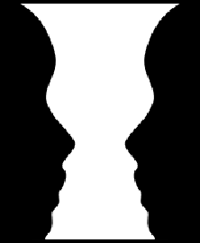
Convolutional Neural Network (CNN)
For further assistance, code and slide https://fahadhussaincs.blogspot.com/
YouTube Channel : https://www.youtube.com/fahadhussaintutorial

Slide 4
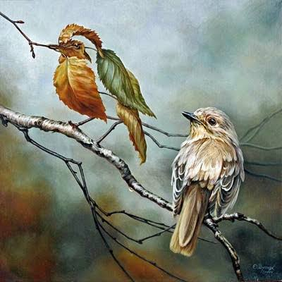
Convolutional Neural Network (CNN)
For further assistance, code and slide https://fahadhussaincs.blogspot.com/
YouTube Channel : https://www.youtube.com/fahadhussaintutorial

Slide 5

But, the question arise, how will be learning in this stage?
Let’s understand the learning first about kids!
For further assistance, code and slide https://fahadhussaincs.blogspot.com/
YouTube Channel : https://www.youtube.com/fahadhussaintutorial

Slide 6
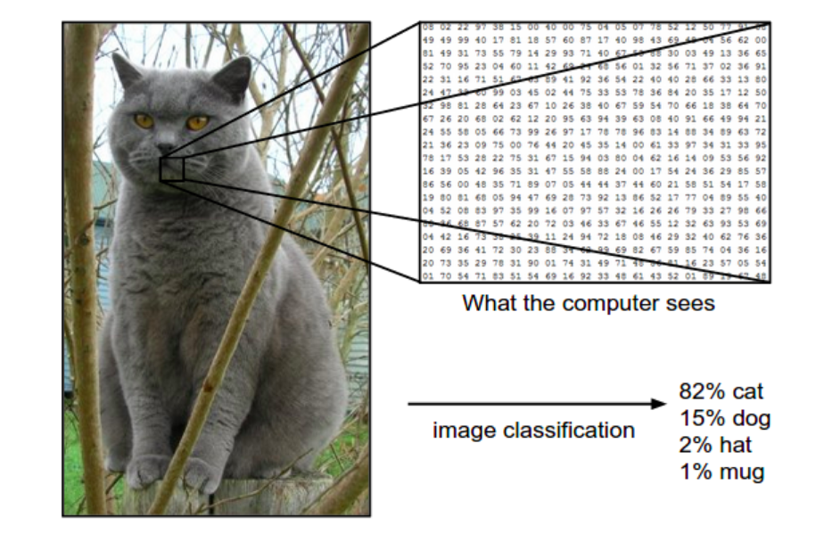
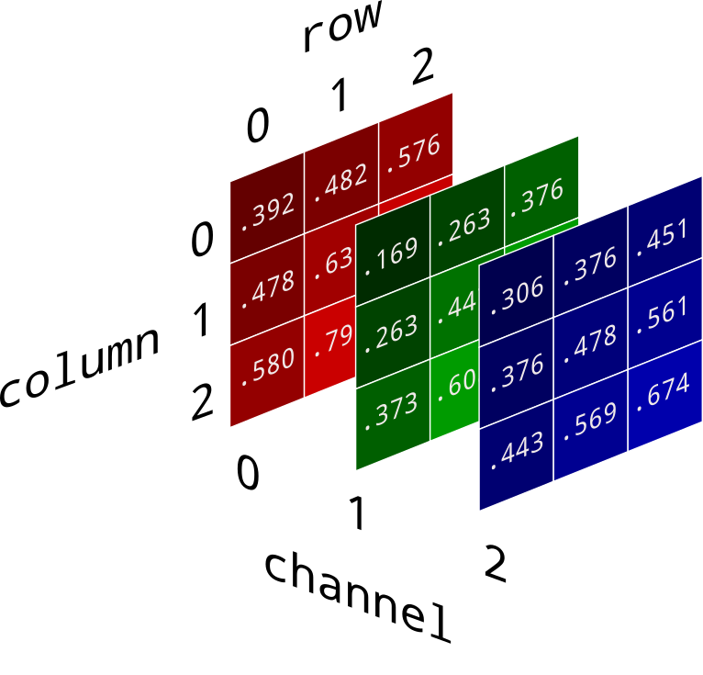
So, what about the Computer? CNN?
Learning… (by image features)
Gray scale image or RGB image
For further assistance, code and slide https://fahadhussaincs.blogspot.com/
YouTube Channel : https://www.youtube.com/fahadhussaintutorial

Slide 7
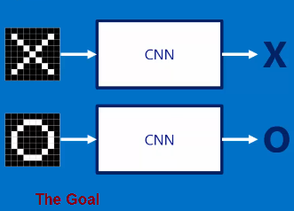
So, what about the Computer? CNN?
Learning…
X
O
Here CNN work as like black box, so what is inside the black box!
For further assistance, code and slide https://fahadhussaincs.blogspot.com/
YouTube Channel : https://www.youtube.com/fahadhussaintutorial

Slide 8
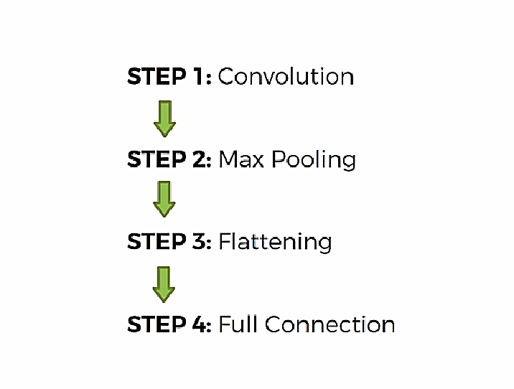
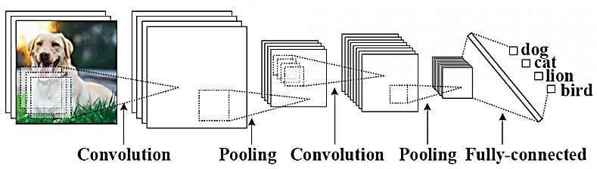
Steps in CNN
For further assistance, code and slide https://fahadhussaincs.blogspot.com/
YouTube Channel : https://www.youtube.com/fahadhussaintutorial

Slide 9
Thanks
For further assistance, code and slide https://fahadhussaincs.blogspot.com/
YouTube Channel : https://www.youtube.com/fahadhussaintutorial

Slide 10
Steps in CNN
For further assistance, code and slide https://fahadhussaincs.blogspot.com/
YouTube Channel : https://www.youtube.com/fahadhussaintutorial

Slide 11
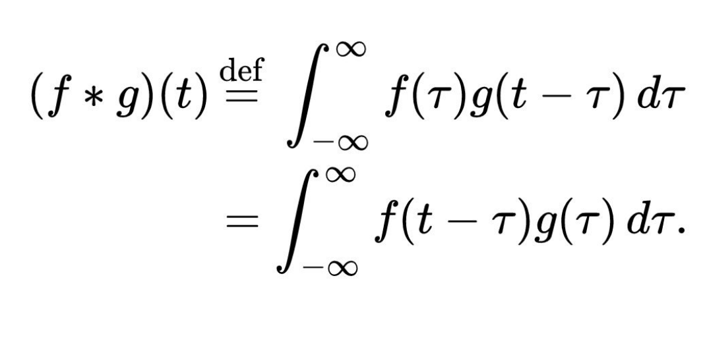
1. Convolutional
For further assistance, code and slide https://fahadhussaincs.blogspot.com/
YouTube Channel : https://www.youtube.com/fahadhussaintutorial

Slide 12
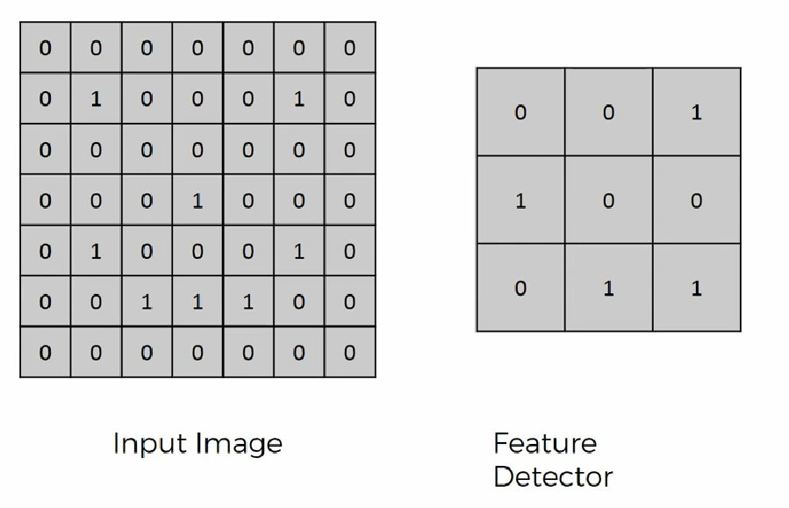
1. Convolutional ( of Smiling Face)
For further assistance, code and slide https://fahadhussaincs.blogspot.com/
YouTube Channel : https://www.youtube.com/fahadhussaintutorial

Slide 13
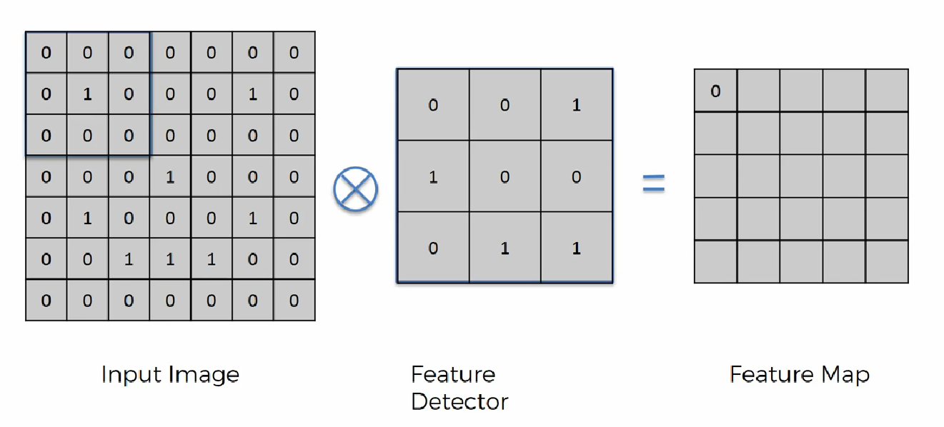
1. Convolutional ( of Smiling Face)
For further assistance, code and slide https://fahadhussaincs.blogspot.com/
YouTube Channel : https://www.youtube.com/fahadhussaintutorial

Slide 14
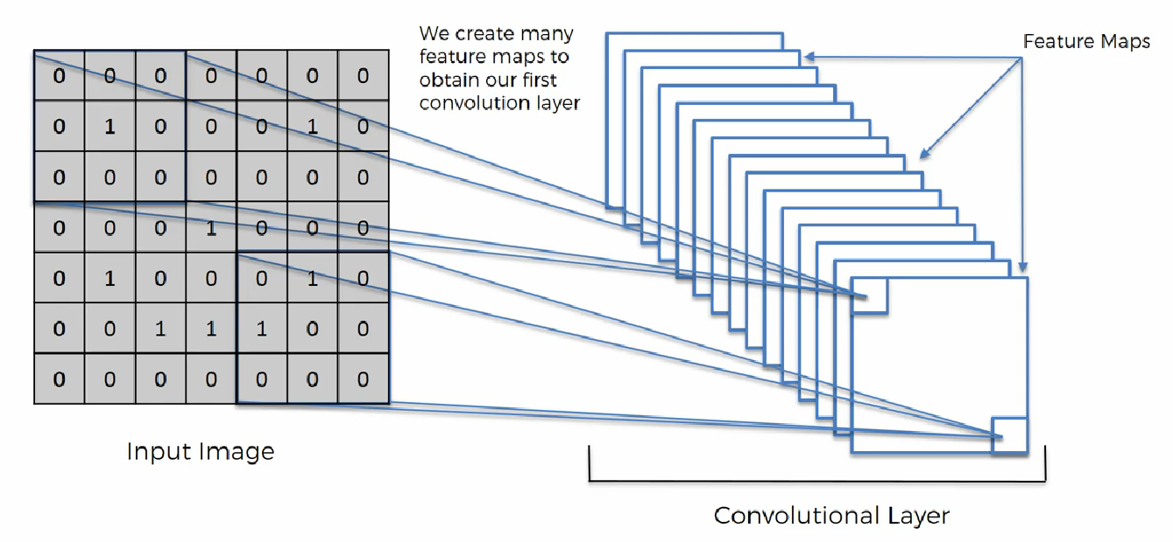
1. Convolutional ( of Smiling Face)
For further assistance, code and slide https://fahadhussaincs.blogspot.com/
YouTube Channel : https://www.youtube.com/fahadhussaintutorial

Slide 15
1. Convolutional ( of Smiling Face)
Different kind of filters / kernels in image processing!
http://setosa.io/ev/image-kernels/
For further assistance, code and slide https://fahadhussaincs.blogspot.com/
YouTube Channel : https://www.youtube.com/fahadhussaintutorial

Slide 16
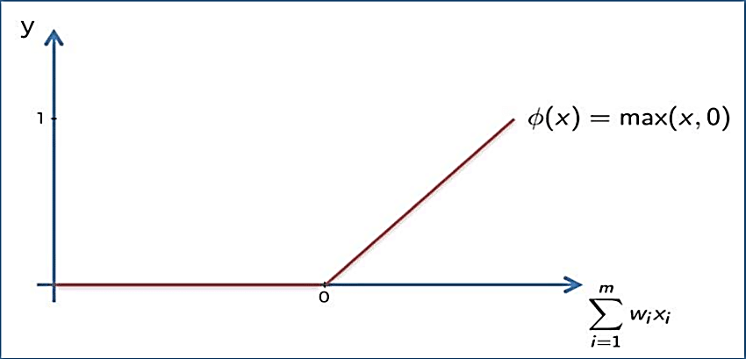
1. Convolutional ( of Smiling Face)
Appling ReLu Activation function to decrease the linearity in the image, because the image originally non linear!
For further assistance, code and slide https://fahadhussaincs.blogspot.com/
YouTube Channel : https://www.youtube.com/fahadhussaintutorial

Slide 17
Thanks
For further assistance, code and slide https://fahadhussaincs.blogspot.com/
YouTube Channel : https://www.youtube.com/fahadhussaintutorial

Slide 18
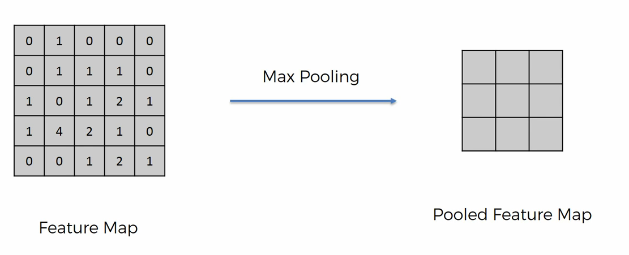
2. Pooling
A pooling layer is another building block of a CNN. Its function is to progressively reduce the spatial size of the representation to reduce the amount of parameters and computation in the network. Pooling layer operates on each feature map independently. The most common approach used in pooling is max pooling.
For further assistance, code and slide https://fahadhussaincs.blogspot.com/
YouTube Channel : https://www.youtube.com/fahadhussaintutorial

Slide 19
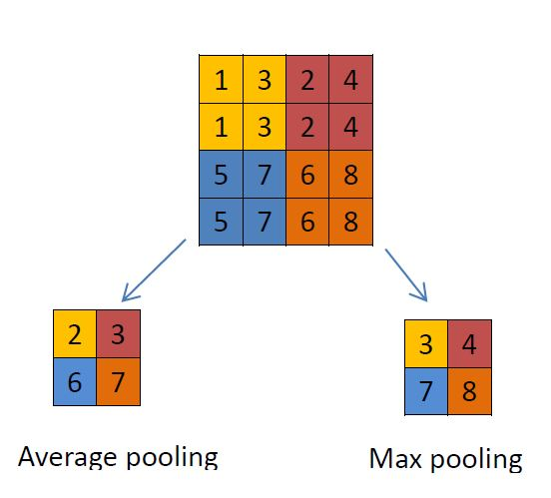
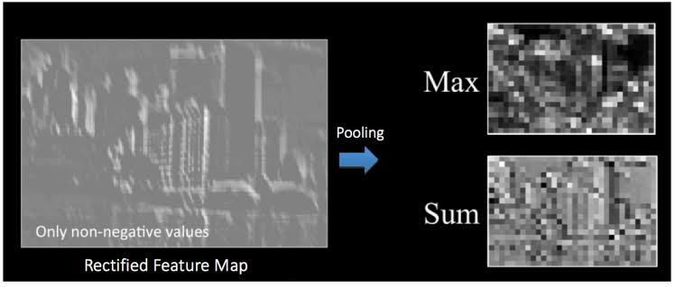
Max / Avg. Pooling
For further assistance, code and slide https://fahadhussaincs.blogspot.com/
YouTube Channel : https://www.youtube.com/fahadhussaintutorial

Slide 20
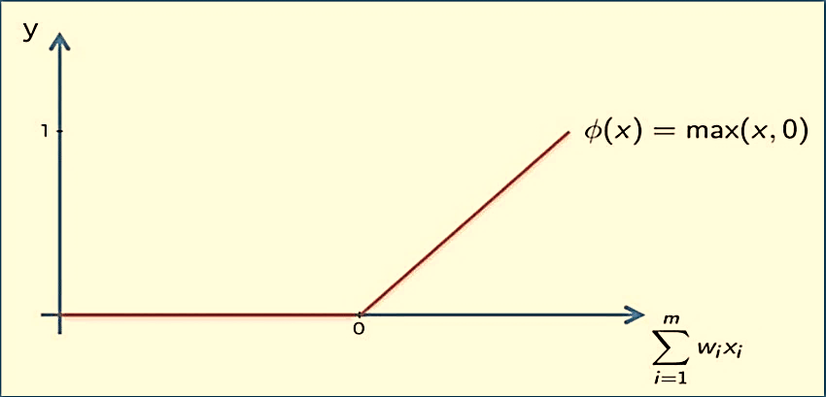
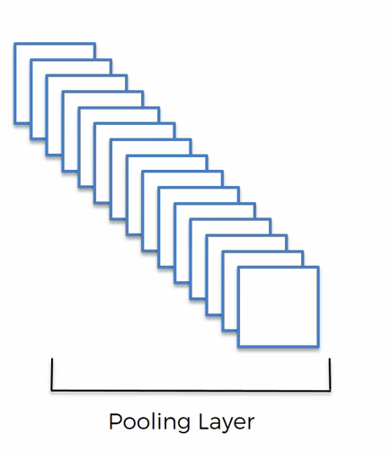
Pooling…
For further assistance, code and slide https://fahadhussaincs.blogspot.com/
YouTube Channel : https://www.youtube.com/fahadhussaintutorial

Slide 21
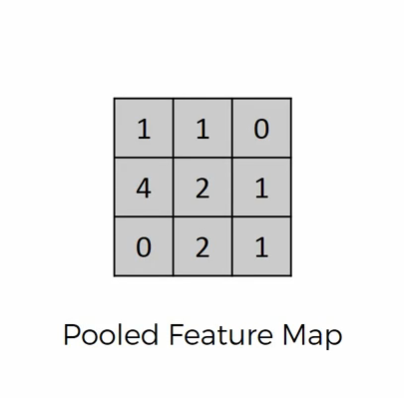
3. Flattening
Flattening is converting the data into a 1-dimensional array for inputting it to the next layer. We flatten the output of the convolutional layers to create a single long feature vector. And it is connected to the final classification model, which is called a fully-connected layer
For further assistance, code and slide https://fahadhussaincs.blogspot.com/
YouTube Channel : https://www.youtube.com/fahadhussaintutorial

Slide 22
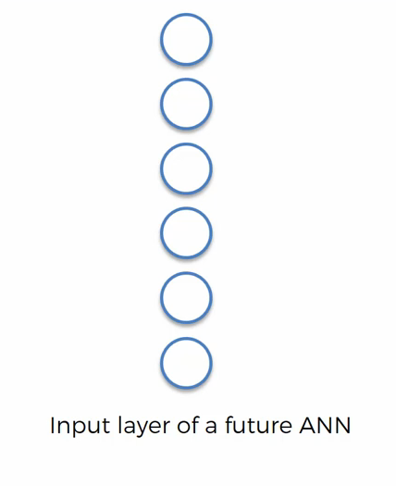
Flattening …
For further assistance, code and slide https://fahadhussaincs.blogspot.com/
YouTube Channel : https://www.youtube.com/fahadhussaintutorial

Slide 23
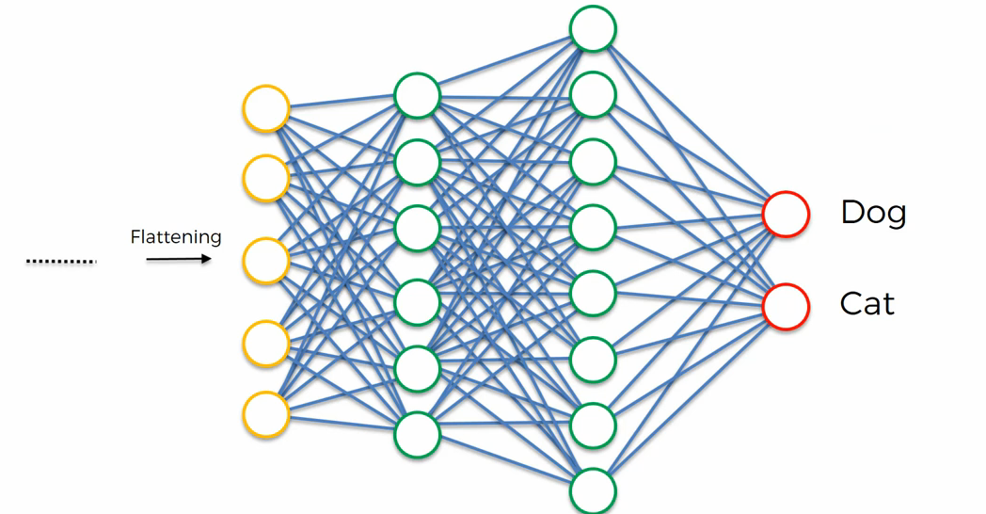
4. Fulling Connection
For further assistance, code and slide https://fahadhussaincs.blogspot.com/
YouTube Channel : https://www.youtube.com/fahadhussaintutorial

Slide 24
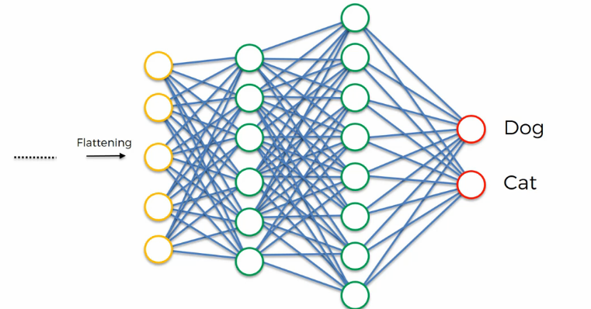
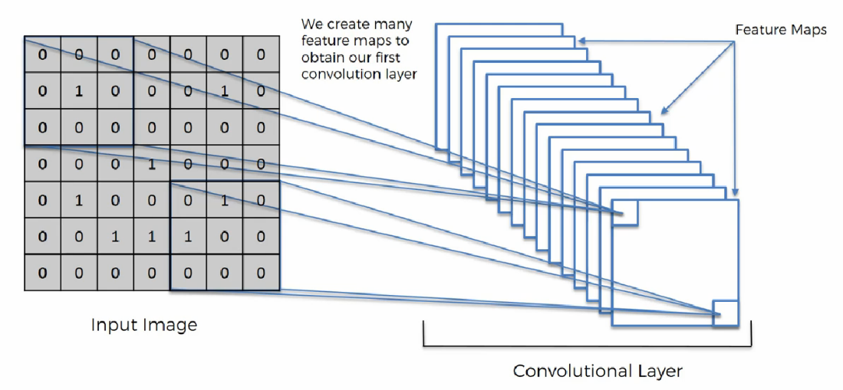
Complete CNN in one View
For further assistance, code and slide https://fahadhussaincs.blogspot.com/
YouTube Channel : https://www.youtube.com/fahadhussaintutorial

Slide 25
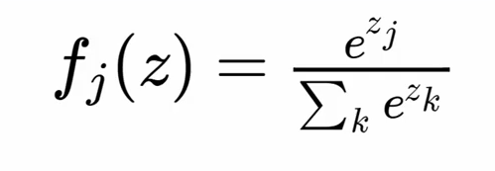
Softmax Activation function…
In mathematics, the softmax function, also known as softargmax or normalized exponential function, is a function that takes as input a vector of K real numbers, and normalizes it into a probability distribution consisting of K probabilities proportional to the exponentials of the input numbers
For further assistance, code and slide https://fahadhussaincs.blogspot.com/
YouTube Channel : https://www.youtube.com/fahadhussaintutorial

Slide 26
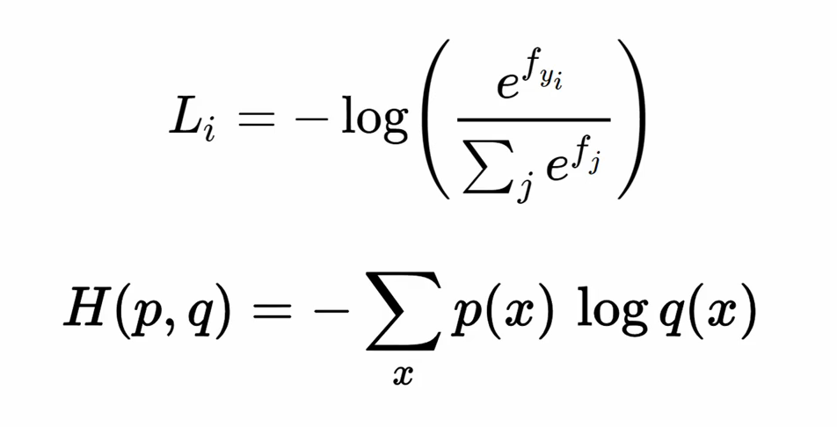
Loss function…
Cross-entropy is commonly used in machine learning as a loss function. Cross-entropy is a measure from the field of information theory, building upon entropy and generally calculating the difference between two probability distributions
0.9
0.1
1
0
For further assistance, code and slide https://fahadhussaincs.blogspot.com/
YouTube Channel : https://www.youtube.com/fahadhussaintutorial

Slide 27
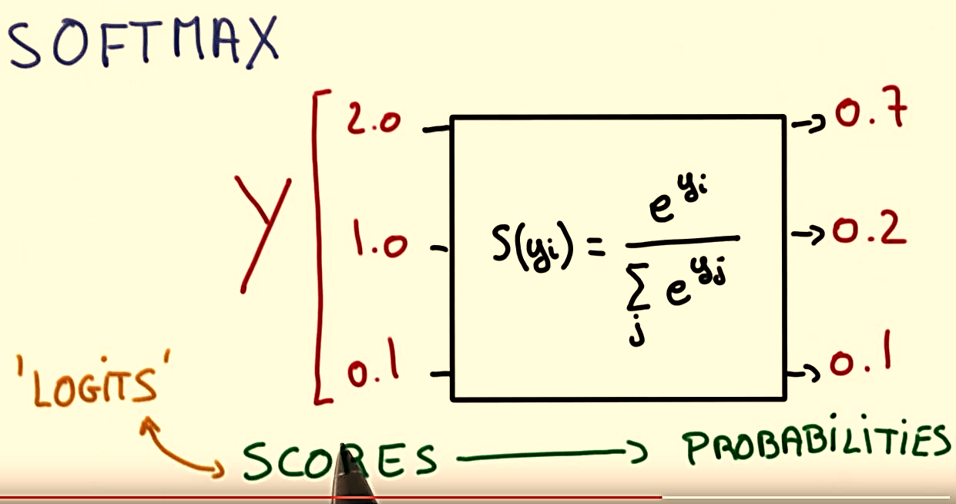
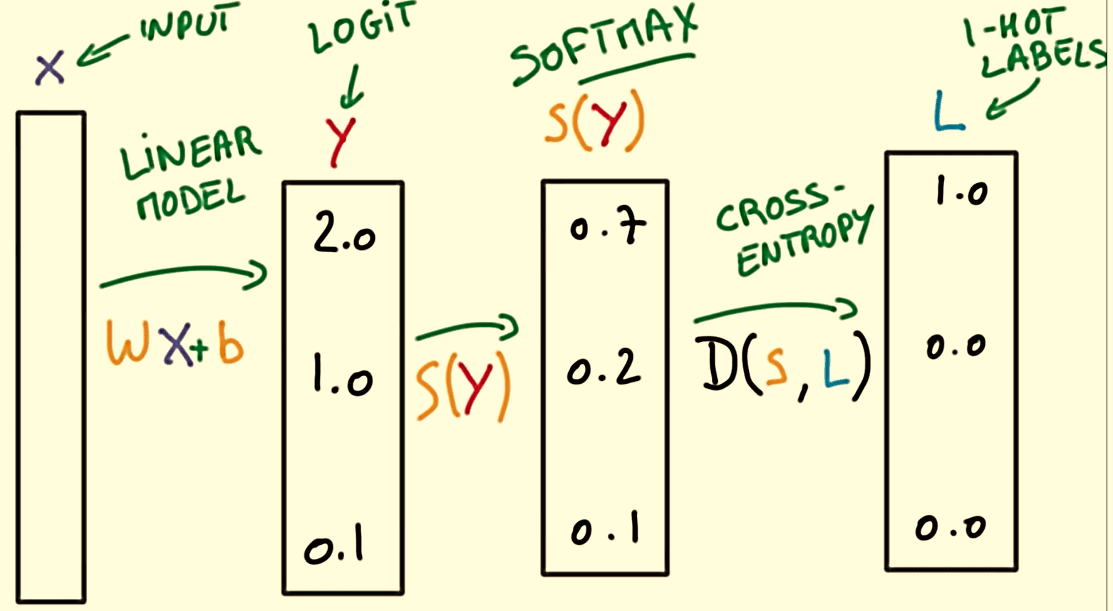
Summarize …
Classification error
RMS
Cross Entropy
For further assistance, code and slide https://fahadhussaincs.blogspot.com/
YouTube Channel : https://www.youtube.com/fahadhussaintutorial

Slide 28
Thanks
https://en.wikipedia.org/wiki/Cross_entropy
https://towardsdatascience.com/understanding-binary-cross-entropy-log-loss-a-visual-explanation-a3ac6025181a
For further assistance, code and slide https://fahadhussaincs.blogspot.com/
YouTube Channel : https://www.youtube.com/fahadhussaintutorial

Slide 29
CNN for Categorical Variables (output)
So far, we have discussed the CNN using binary outcome result (0,1), so what about the Categorical variable result means more than 0,1 therefore we are going the understand the CNN using MNIST dataset.
So, what is MNIST dataset...
It is a data-set, consisting images of handwritten digits from 0 to 9. Each image is a monochrome, 28 * 28 pixels.
For further assistance, code and slide https://fahadhussaincs.blogspot.com/
YouTube Channel : https://www.youtube.com/fahadhussaintutorial

Slide 30
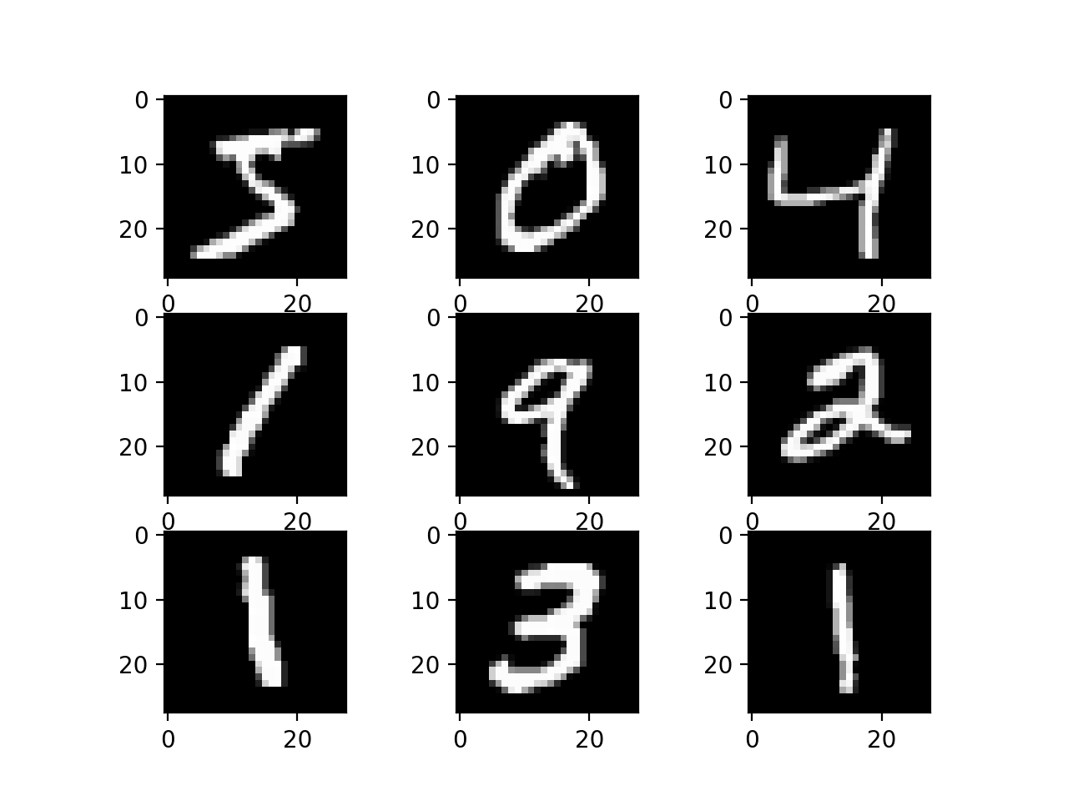
MNIST DATASET History
1980 Era of improving of image and signal processing, here the problem of zip code reading still big challenge!
In the 1989 yann lecun solve this
Problem by adding fourth layer
Convolutional layer in CNN.
For further assistance, code and slide https://fahadhussaincs.blogspot.com/
YouTube Channel : https://www.youtube.com/fahadhussaintutorial

Slide 31
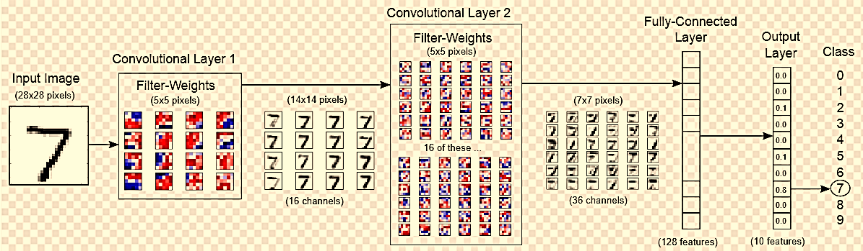
MNIST CNN
For further assistance, code and slide https://fahadhussaincs.blogspot.com/
YouTube Channel : https://www.youtube.com/fahadhussaintutorial

Slide 32
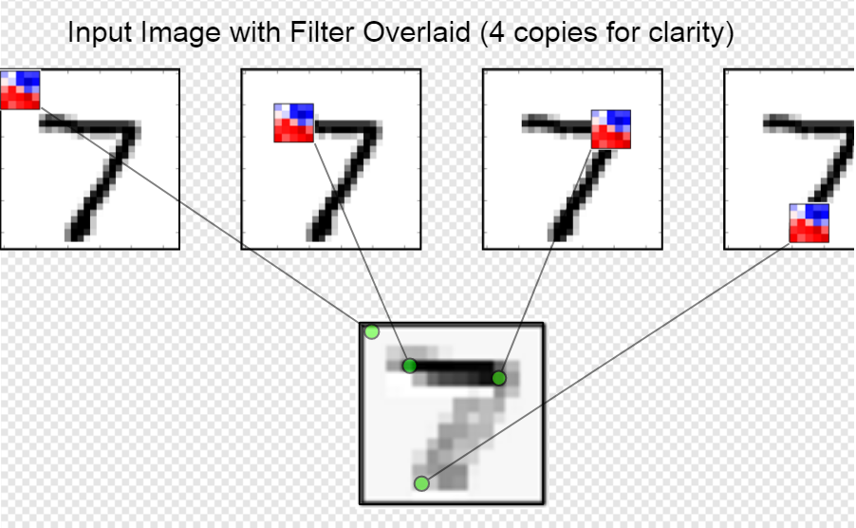
MNIST CNN
For further assistance, code and slide https://fahadhussaincs.blogspot.com/
YouTube Channel : https://www.youtube.com/fahadhussaintutorial

Slide 33
Useful links:
https://en.wikipedia.org/wiki/MNIST_database
http://yann.lecun.com/exdb/mnist/
http://colah.github.io/posts/2014-10-Visualizing-MNIST/
Lets move towards CODE!
For further assistance, code and slide https://fahadhussaincs.blogspot.com/
YouTube Channel : https://www.youtube.com/fahadhussaintutorial

